Slide 1
ORDER MANAGEMENT
APPLICATION
PRIYAM DUTTA

Slide 2
ABSTRACT
The order management system is a Salesforce app and environment meant to facilitate the creation and approval of orders generated by a firm’s clients. The firm’s order handing team comprises employees in sales, business and support roles. The system is meant to handle how an employee interacts with and handles order and client data, while overriding the standard sales cloud utility with customizable lightning web components.

Slide 3
OVERALL UTILITY FEATURES
1, Gives different sets of users various permissions.
2. Dynamic order management

Slide 4
SCOPE
Support user, Business User and Sales User were given their own specific functionality as per the use case.
Order approval was automated.
Triggers were used to apply business logic.
Lightning Web Components used to create app home page and override actions(wrapped in aura component).

Slide 5
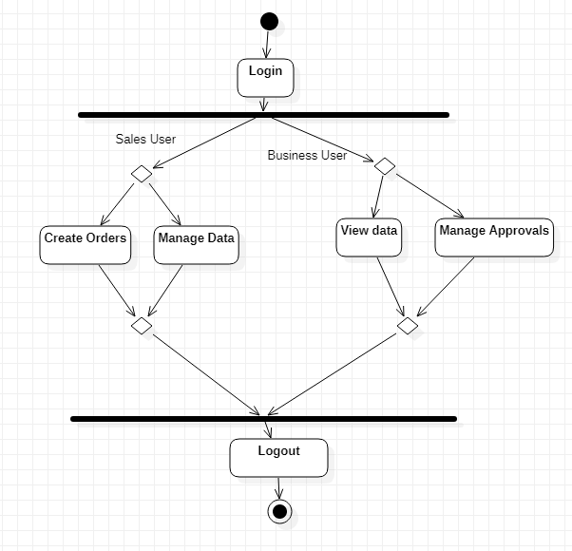
ACTIVITY DIAGRAM FOR SALES/BUSINESS USER

Slide 6
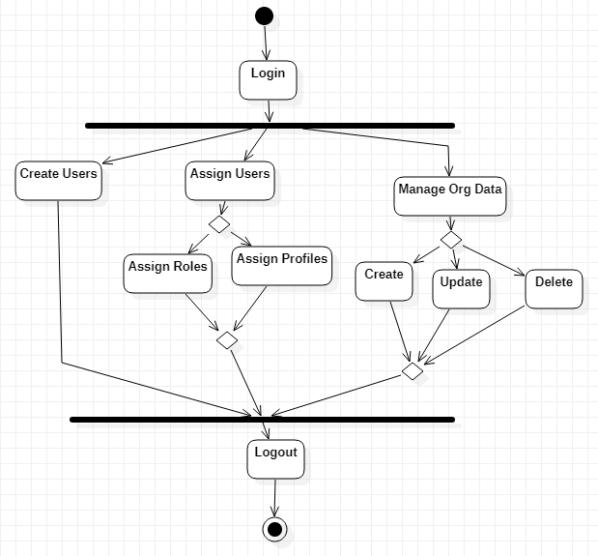
ACTIVITY DIAGRAM FOR SUPPORT USER

Slide 7
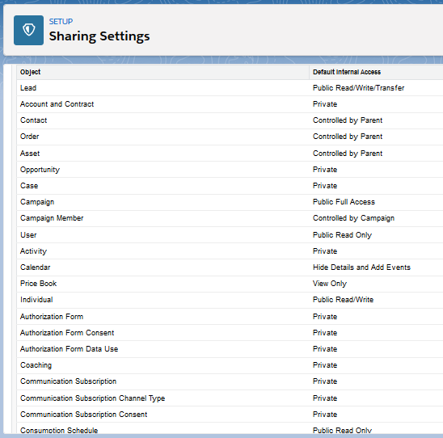
ADMIN COMPONENTS
Sharing and Security

Slide 8
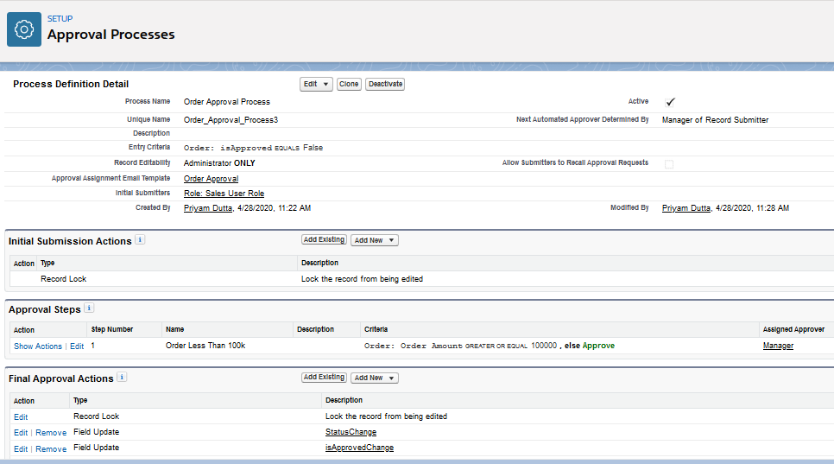
ADMIN COMPONENTS
2. Approving Orders

Slide 9
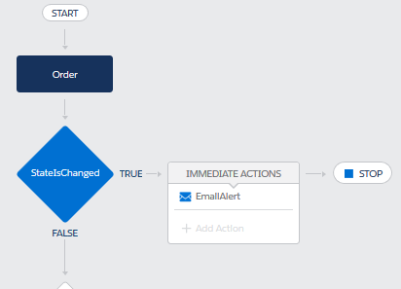
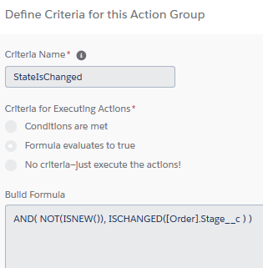
ADMIN COMPONENTS
3. Notification Process

Slide 10
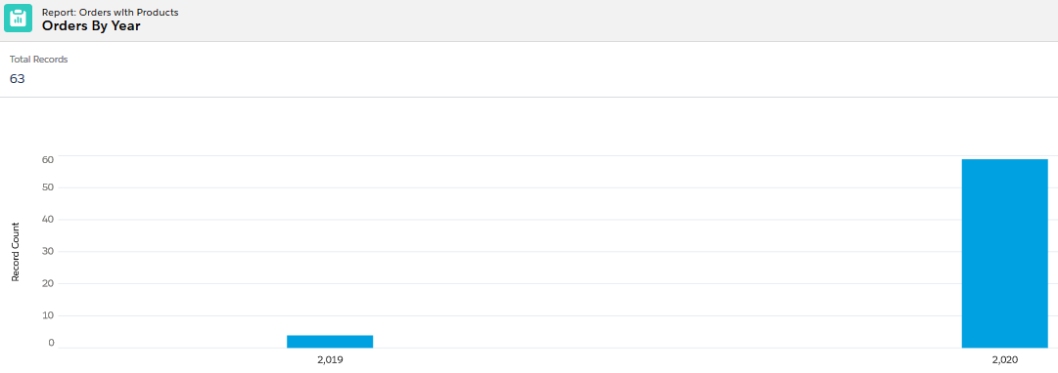
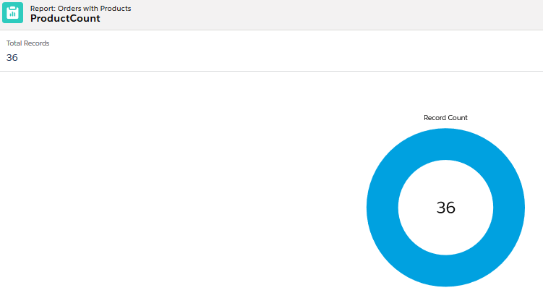
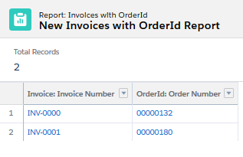
ADMIN COMPONENTS
4. Reports and Dashboards

Slide 11
DEV COMPONENTS
Lightning Web Components
Overriding Order Creation
Order Capture Screen

Slide 12
DEV COMPONENTS
Apex Triggers
Trigger on User : To restrict managers
Trigger on Order : To restrict order Stage reversion
Trigger on Order Item : To maintain stocks
Trigger on Account : To check and maintain owner details
Trigger on Invoice : To update order stage based on invoice details

Slide 13
DEV COMPONENTS
Aura Component
For the purpose of allowing the custom LWC to be overridden.
Visualforce Component
To display a personalised message to the order viewer.

Slide 14
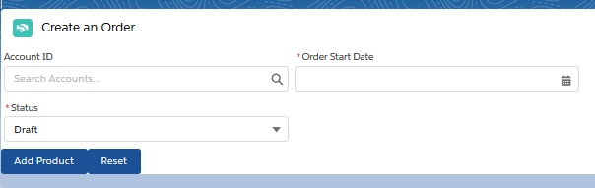
SCREENSHOTS
Order Creation

Slide 15
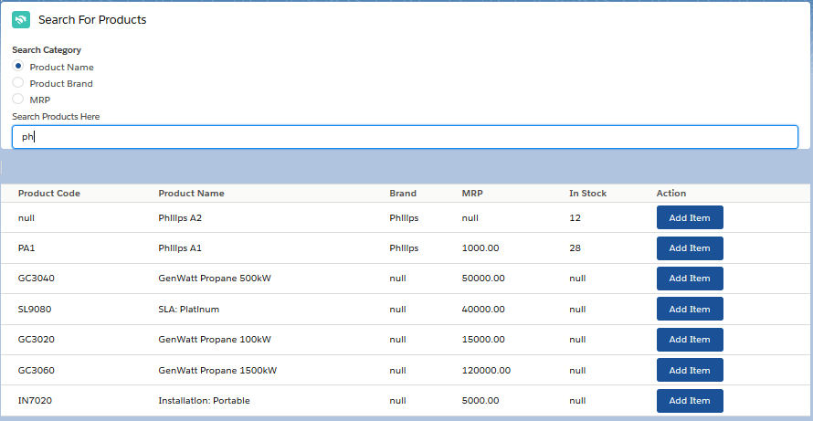
SCREENSHOTS
Searching Products

Slide 16
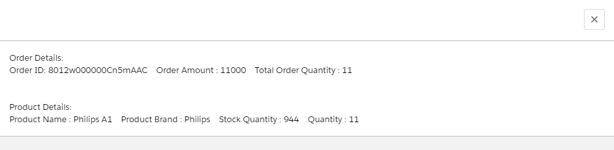
SCREENSHOTS
Order Summary

